Slide 1
Asymptotic Notation Divide and Conquer
Junyi Ouyang

Slide 2













Arrange these functions under the Big-O notation in increasing order of growth rate with g(n) following f (n) in your list if and only if f(n) = O(g(n)) (here, log(x) is the natural logarithm of x, with the base being the Euler’s number e) :
$$2^{log(n)}$$
$$2^{3n}$$
$$3^{2n}$$
$$n^{nlog(n)}$$
$$log(n)$$
$$log(n!)$$
$$nlog(n^{2})$$
$$log(log(n^{n}))$$
$$n^{n^{2}}$$
$$log(log(n^{n}))$$
$$log(n)$$
$$2^{log(n)}$$
$$log(n!)$$
$$nlog(n^{2})$$
$$2^{3n}$$
$$3^{2n}$$
$$n^{nlog(n)}$$
$$n^{n^{2}}$$
1. $log(log(n^{n}))=log(nlog(n))=log(n)+log(log(n))=O(log(n))$
2. $2^{log(n)}=O(n)$
3. $log(n!)=\sum_{k=1}^{n}{log(k)<nlog(n)<2nlog(n)=nlog(n^{2})}$
4. $2^{3n}=8^{n} ,3^{2n}=9^{n}$

Slide 3

True or False
If $f(n) = Ω(nlogn)$ and $g(n)=O(n^{2}log(n))$, then $f(n) = O(g(n))$.
False. Example, $f (n) = n^{2}, g(n) = n$.

Slide 4
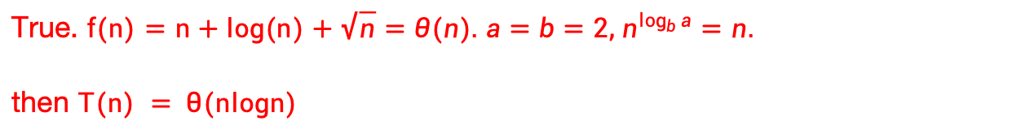
True or False
If $T(n) = 2T(n/2)+n+log(n)+\sqrt{n}$, then $T(n) = θ(nlogn)$
True. $f(n)=n+log(n)+\sqrt{n}=θ(n). a=b=2, n^{\log_{b}{a}}=n.$
then $T(n) = θ(nlogn)$

Slide 5

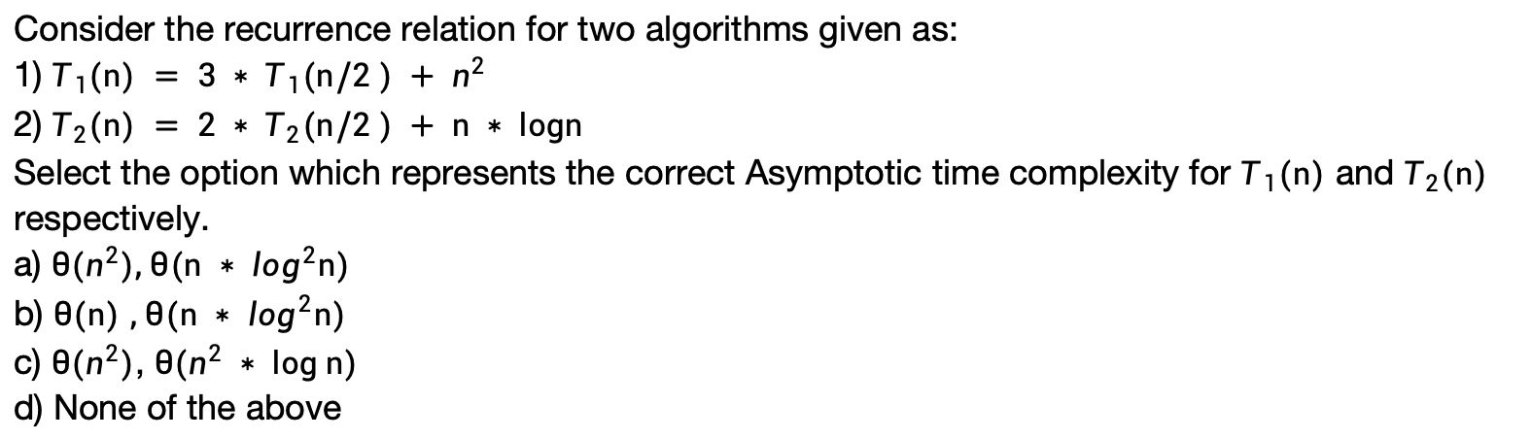
MCQ
Consider the recurrence relation for two algorithms given as:
1) $T_{1}(n) = 3 ∗ T_{1}(n/2 ) + n^{2}$
2) $T_{2}(n) = 2 ∗ T_{2}(n/2 ) + n ∗ logn$
Select the option which represents the correct Asymptotic time complexity for $T_{1}(n)$ and $T_{2}(n)$ respectively.
a) $θ(n^{2}), θ(n ∗ \log^{2}n)$
b) $θ(n)$ $, θ(n ∗ \log^{2}n)$
c) $θ(n^{2})$, $θ(n^{2} ∗ log n)$
d) None of the above
Answer: a.
For $T_{1}(n)$:
It falls under the case 3 of master theorem where $f(n) =n^{2}$ and
$\log_{b}{a}=\log_{2}{3}<2$ . Thus, we get the time complexity of $T_{1}(n) =θ(n^{2})$
For${ T}_{2}(n)$:
It falls under the case 2 of master theorem where $f(n) =n log n$ and
$\log_{b}{a}=\log_{2}{2}=1$ .
Thus, we get the time complexity of $T_{2}(n) =θ(n ∗ \log^{2}n)$

Slide 6
Fixed Point
Given an array of n distinct integers sorted in ascending order, we are interested in finding out if there is a Fixed Point in the array. Fixed Point in an array is an index i such that arr[i] is equal to i. Note that integers in the array can be negative.
Example: Input: arr[] = -10, -5, 0, 3, 7 Output: 3, since arr[3] is 3
a) Present an algorithm that returns a Fixed Point if there are any present in the array, else returns -1. Your algorithm should run in O(log n) in the worst case.
b) Use the Master Theorem to verify that your solutions to part a) runs in O(log n) time.
c) Let’s say you have found a Fixed Point P. Provide an algorithm that determines whether P is a unique Fixed Point. Your algorithm should run in O(1) in the worst case.

Slide 7
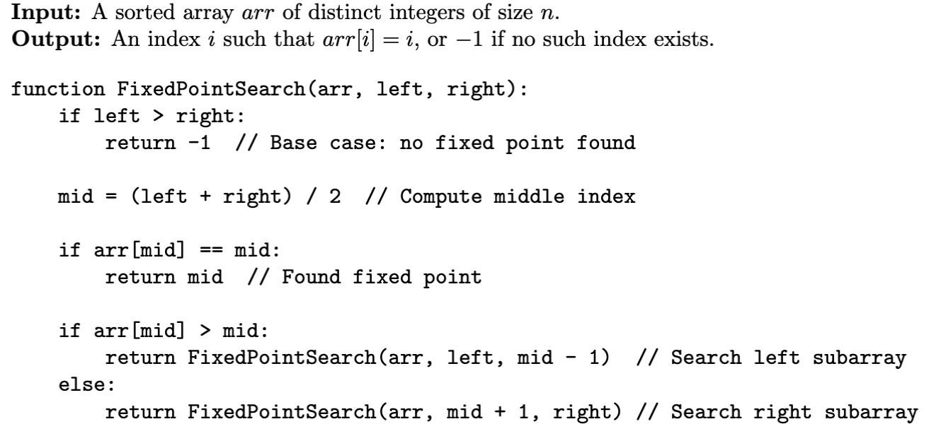
Fixed Point
Fixed Point in an array is an index i such that arr[i] is equal to i.
a) Present an algorithm that returns a Fixed Point if there are any present in the array, else returns -1. Your algorithm should run in O(log n) in the worst case.
index 0 1 2 3 4 5 6
value ? ? 3 ? ? ? ?
For every k > mid, arr[k]>=arr[mid]+k-mid >mid+k-mid = k

Slide 8

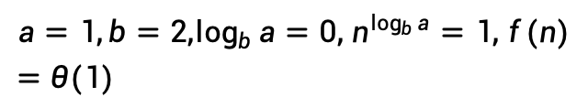

Fixed Point
Fixed Point in an array is an index i such that arr[i] is equal to i.
b) Use the Master Theorem to verify that your solutions to part a) runs in O(log n) time.
$$T(n)=T(n/2)+θ(1)$$
$$a=1,b=2,\log_{b}{a}=0, n^{\log_{b}{a}}=1, f(n)=θ(1)$$
case 2, $T(n)=θ(logn)$

Slide 9
Fixed Point
Given an array of n distinct integers sorted in ascending order. We need to find Fixed Point which is an index i such that arr[i] is equal to i.
c) Let’s say you have found a Fixed Point P. Provide an algorithm that determines whether P is a unique Fixed Point. Your algorithm should run in O(1) in the worst case.
Say a fixed point is found at index i. Check indices i+1 and i-1. If we don’t find fixed points at these two indices, then there cannot be any other fixed points.
Because the array is sorted and all elements are distinct integers. Hence, for all other elements j above i, we must have arr[j] > j. And for all elements j below i, we must have arr[j] < j.

Slide 10
Count Inversion
Given an array of integers nums, count the number of pairs (i, j) that i < j and num[i] > num[j]. You should use Divide and Conquer to solve this problem and the time complexity should be θ(NlogN).

Slide 11
Count Inversion
Given an array of integers nums, count the number of pairs (i, j) that i < j and num[i] > num[j]. You should use Divide and Conquer to solve this problem and the time complexity should be θ(NlogN).
By D&C, #pairs=#pairs_left+#pairs_right+#pairs_left_right
How to compute #pairs_left_right?

Slide 12
Count Inversion
Given an array of integers nums, count the number of pairs (i, j) that i < j and num[i] > num[j]. You should use Divide and Conquer to solve this problem and the time complexity should be θ(NlogN).
How to compute #pairs_left_right?
To achieve θ(NlogN), T(n) must have recurrence relation like: T(n)=2T(n/2)+θ(n)
But naive solution to get #pairs_left_right is having 2 pointers for left and right part, making it θ(n^2).

Slide 13
Count Inversion
Given an array of integers nums, count the number of pairs (i, j) that i < j and num[i] > num[j]. You should use Divide and Conquer to solve this problem and the time complexity should be θ(NlogN).
How to compute #pairs_left_right?
Naive solution to get #pairs_left_right is having 2 pointers for left and right part, making it θ(n^2).
Sort the left and the right part, then θ(n^2) -> θ(n) (merge part of mergesort).

Slide 14
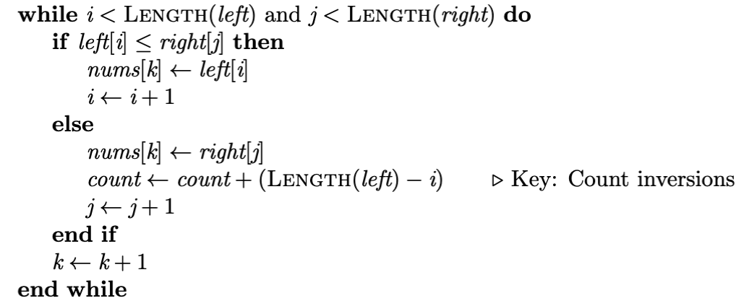
Count Inversion
How to compute #pairs_left_right?
Sort the left and the right part, then θ(n^2) -> θ(n) (merge part of mergesort).
Specifically
Left: 3 6 9
Right: 2 7 8
1. right=2, 3>2,6>2,9>2, count+=3=3-0
2. right=7, 9>7, count+=1=3-2=length(left)-2
3. right=8, ...

Slide 15
Count Inversion
Given an array of integers nums, count the number of pairs (i, j) that i < j and num[i] > num[j]. You should use Divide and Conquer to solve this problem and the time complexity should be θ(NlogN).
1. Mergesort with counter.
2. Use the Master Theorem to analyze time complexity.

